Slide 1
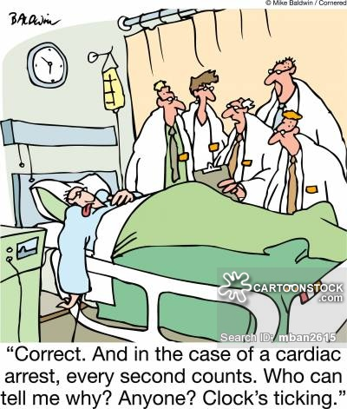
Communication and Leadership
Bob Marshall, MD MPH MISM FAAFP
Program Director, DoD/MAMC Clinical Informatics Fellowship

Slide 2
Learning Objectives
Provide background on communication
Go over the principles of effective communication
Discuss the various roles a leader must assume as a communicator
Review the 10 principles of becoming an effective communicator
Discuss communication and relationship management
Review three communication styles

Slide 3
Background
Already discussed leadership and management
One cannot be good at either without effective communication capabilities
There are all kinds of models of communication, some basic and some complex
An operational description of communication is Creating Understanding
Communication is achieved through words, actions, body language, voice tone and other processes
The other half of communication consists of verifying that the message you intended to send was actually received and interpreted the way you intended
The only way to be sure you have created understanding is to listen to the people you are communicating with, having them reflect back what they heard

Slide 5
Effective communication 1 of 5
Verbal and nonverbal communication
Verbal communication is the most obvious form of communication
However, people pay much less attention to the words and much more attention to the actions and nonverbal cues that accompany the words
Nonverbal cues include facial expressions, use of hand motions, body posture and eye movements
It is critical for leaders to match nonverbal cues with the words; when they do so, they are more believable and trustworthy

Slide 6
Nonverbal communication examples
Face to Face:
Verbal (words) 7%
Body language 55%
Vocal (tone) 38%
Telephone:
Words (verbal) 12%
Vocal (tone) 87%
Body language 1%
Every part of you is involved in communications -
it defines who you are and the type of interaction you want with your listener

Slide 7
Effective communication 2 of 5
Adapting styles
A good leader adapts his or her communication style depending on the audience
When speaking to subordinates, he or she may need to have a much more directive style than when delivering a presentation to the community or to customers
Leaders should identify the audience as well as the audience characteristics and interests; he or she should then adjust their communication style and content based on what the audience needs as well as what the leader needs to create understanding and obtain the desired outcome
Even throughout the course of a single day, a leader may have to switch between an authoritative style and other styles depending on the audience

Slide 8
Effective communication 3 of 5
Listening
A critical component of communication is the ability to listen as well as to speak
Active listening should always be a goal, with the leader focusing on both the verbal and nonverbal language of the speaker
Active listening involves concentrating only on the speaker and ignoring outside interruptions, which includes the listeners own wandering thoughts or possible responses
Active listeners refrain from interrupting, giving the speaker time to finish, showing they are listening by doing things like nodding or smiling, or reflecting/paraphrasing back to verify their understanding

Slide 9
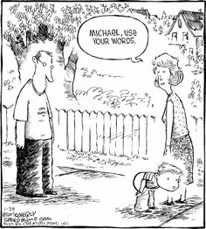

Slide 10
Effective communication 4 of 5
Setting an example
Leaders and managers should realize that subordinates will look to them as a model of how they should behave under certain circumstances
Subordinates tend to emulate how the sea leaders acting and communicating
If subordinates feel you are using an active listening style and empathetic tone with customers, they are much more likely to do the same
When leaders are open to the ideas of others and praise often, subordinates will tend to follow suit
When speaking, leader should consider whether or not they would want their subordinates to speak in the same way to the same audience
If not, the leader should adjust his or her communication style accordingly

Slide 11
Effective communication 5 of 5
Considerations
Effective communication skills do not come naturally for most people
Most people need to practice repeatedly in order to improve their skills
In addition to practicing, leaders should consider classes or training that will help them communicate effectively
Using 360° evaluations, every person in the organization as evaluated by one or more superiors, colleagues and subordinates
Leaders can and should participate in 360° evaluations, both to serve as an example for subordinates and to identify whether or not their own communication skills need improvement

Slide 12
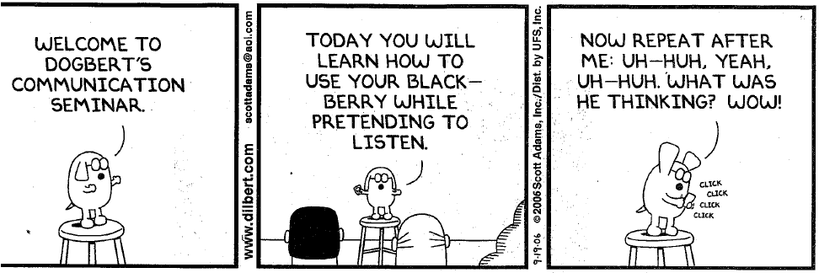

Slide 13
Communication structure
Every type of communication has three components:
Content: what is the communication about
Context: those attributes that surround the content and give it linkage and meaning with its surroundings
Structure: the ‘bones’ of the communication; how it is organized, how it is delivered, and the framework for interpretation.

Slide 14
Whose Responsibility is communication
The responsibility for the communication process must rest with management at all levels across the organization
Poor communication is repeatedly cited as a key contributor in the failure of major change efforts, communication skills are increasingly regarded as a critical skill set for leaders, particularly in situation where the leader is the instrumental driver of change
Communication skills, both in terms of personal ability and strategic capability, are being given increasing importance in leadership competency models
Leaders who stand out from the crowd are those with exemplary communication skills

Slide 15
Leaders play three roles as communicators
Communication is a complex process that must be addressed from many angles to achieve the best results
Leaders must understand all components of the communication process to apply them effectively
To have impact, careful communication planning and management, as well as clarity and consistency of messages are key factors
Unfortunately many communication efforts focus only on the delivery of a message and neglect the vital planning and management of the process
The speed and volume offered by technology through such channels as email and Internet are often erroneously equated to effective communication

Slide 16
Integrated Communication Roles

Slide 17
Communication infrastructure builder role
In this role, the leader must consider a number of issues:
The organizational culture
The current communication climate
Identification of various changes that impact stakeholders
Integration of communication with other human resources practices

Slide 18
Communication program strategy role
In developing a strategy for communication, the leader should do the following:
Analyze each stakeholder and the impact of the changes for them
Determine measurable communication objectives
Develop a clear, consistent message that is meaningful to the stakeholders
Select and use appropriate communication channels
Measure the effectiveness of the communication effort and adjust the strategy as necessary

Slide 19
Communication tactical role
Once the infrastructure and strategy are developed/assured, the leader takes on tactical role as a communicator. At this point, fundamental communication skills are important
Presentation skills
Asking effective questions
Listening skills
Facilitation and problem-solving
Conducting high impact conversations
Coaching and mentoring skills (one on one communication)

Slide 20
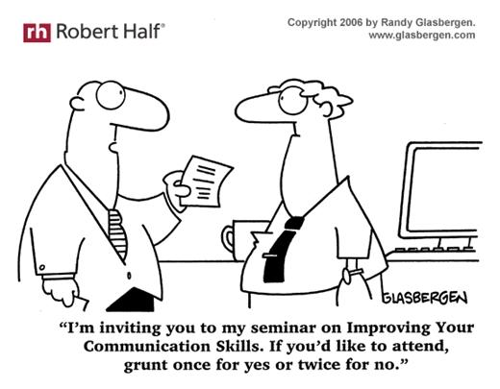

Slide 21
Planning
Give me six hours to chop down a tree, and I will spend the first four sharpening the axe.
----Abraham Lincoln
Plans are worthless; planning is indispensable.
-----Dwight D. Eisenhower

Slide 22
Becoming an excellent communicator
10 principles to follow
Speak not with a forked tongue
Get personal
Get specific
Focus on the leave-behinds, not the takeaways
Have an open mind
Shut up and listen
Read between the lines
When you speak, know what you’re talking about
Speak to groups as individuals

Slide 23
Communication and relationship management
Communication and relationship management is about how clearly leaders understand the people they work with and how effectively use that knowledge in building high-performance working relationships
The Healthcare Leadership Alliance (HLA) identified multiple domains associated with this competency
Of the domains, the one competency that stands out is pivotal to the effectiveness of all the rest is demonstrating integrity and engendering trust
Overall, the domains are: knowing the organization’s structure and relationships; understanding public relations; communicating organizational mission and vision; facilitating alternative dispute resolution; practicing and valuing shared decision making; creating, participating in, and leading teams; identifying and using resources to help deliver communications; identifying stakeholder expectations; demonstrating integrity; and engendering trust

Slide 24
Demonstrating Integrity
While high ethical standards are very important in healthcare leadership, ethics is best characterized as necessary but not sufficient for leadership effectiveness
In a broader sense, leadership integrity occurs when the people the leaders work with view their decisions and actions as clear and consistent
Leaders who make a point of seeking input from the people they work with, making decisions in a methodical manner and explaining their thinking to those affected by their decisions will be viewed as having higher integrity

Slide 25
Engendering Trust
While integrity generally revolves around an individual’s clarity of purpose and action, engendering trust relates to how a specific individual use his or her working relationship with a specific leader
Trust is generally not given or gained freely
Subordinates will not trust the leader and tell that leader has earned their trust through a combination of displaying integrity and demonstrating that the leader understands and respects subordinates wants and needs
Once earned, trust carries forward only with regular maintenance and can easily be diminished or even a single indiscretion
Leading effectively in such a climate requires consistency, not only in purpose, but also in follow-through
The leader must constantly be asking, about each person they work with, what commitments have I made to this person, and how well I doing in meeting those commitments?

Slide 26
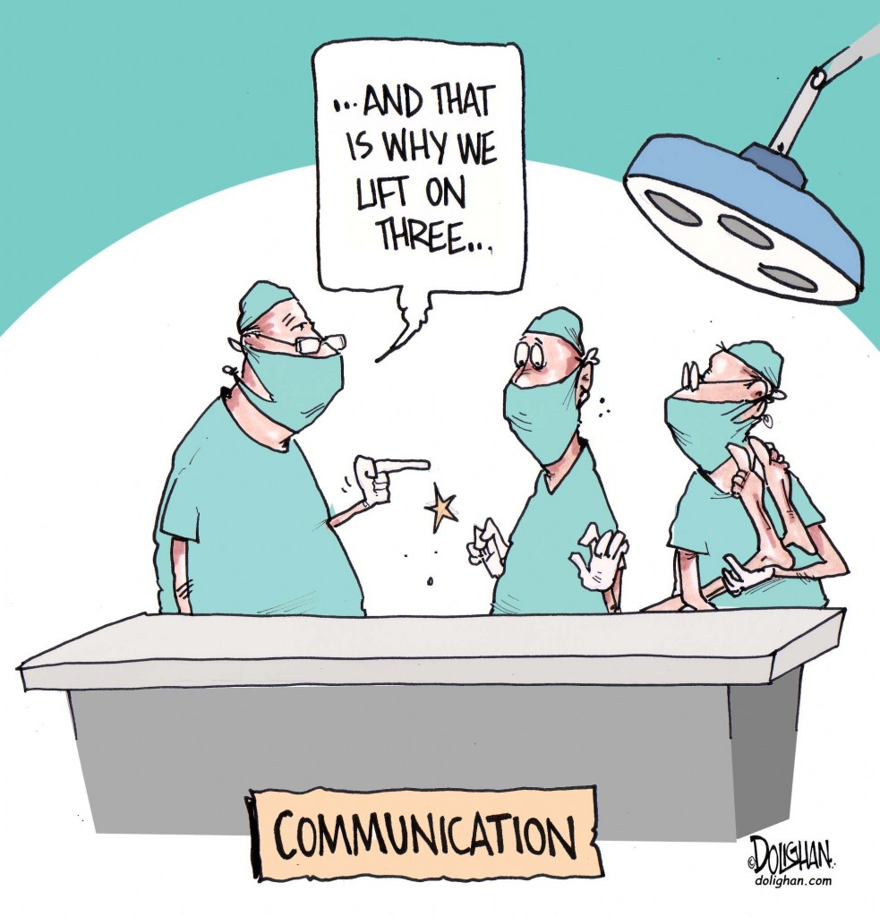

Slide 27
Leadership communication styles 1 of 3
Transformational leadership
James McGregor Burns defined transformational leadership in 1978 as the following: where in one or more persons engage with others in such a way that leaders and followers raise one another to higher levels of motivation and morality
Key factors in transformational leadership include charisma, individualized consideration and intellectual stimulation
Motivation also plays a significant role for transformational leaders, especially since it leads to success and an optimistic outlook for the organization as a whole
Transformational leaders are not set in their ways; they are open to change and often appreciate a creative approach to problem-solving and teamwork

Slide 28
Leadership communication styles 2 of 3
Transactional leadership
This occurs when a person takes the initiative in making contact with others for the purpose of an exchange of valued items
The exchange could be financial, social or emotional in nature
Transactional leadership has two components: exchanging rewards contingent upon the exhibition of desired behaviors and results, and intervenes when performance falls short
Transactional leaders are different from transformational leaders in a fundamental sense: they work within the boundaries in the existing standards of the organization
Few risks are taken and the focus of the work is on efficiency, control, stability and predictability
While transformational and transactional leaders are quite different, they are complementary in nature

Slide 29
Leadership communication styles 3 of 3
Servant leadership
These types of leaders focus on the service aspect first as they often have a natural tendency to help others
Once the service is achieved, the individual aims to lead as a result of this achievement
The best way to determine whether a person is a servant leader is to identify whether they grow as a person, become healthier and are more likely to develop an autonomous and selfless desire to serve others
Servant leadership is a long-term, transformational approach to life and work with the goal of creating change throughout society
Certain characteristics are felt central to the development of servant leaders: listening, empathy, healing, awareness, persuasion, conceptualization, foresight, stewardship, commitment to the growth of people and building community

Slide 30

Questions

